Slide 1

# Notes App
# Code Refactoring and Bug Fixing
Link to Repository :
https://github.com/RajasekharRapaka/Code-Refactoring-and-Bug-Fixing/tree/main/Take_Notes_Web_Application
- Raja Sekhar Rapaka

Slide 2
About me
Skills
Programming : Python
Databases : SQL
Data Visualization : Tableau
Statistical Analysis
Machine Learning
Deep Learning
Computer Vision
Natural Language Processing (NLP)
Web Application Development
AWS Application Deployment
ML Ops
Prompt Engineering
Raja Sekhar Rapaka
Education: B.Sc in Information Technology
Occupation: US IT Bench Sales Recruiter (3 years)
Introduction :
Enthusiastic and results-oriented professional with a solid background in Information Technology and an unwavering enthusiasm for Data Science. Leveraging three years of experience as a US IT Bench Sales Recruiter, I have developed strong competencies in client engagement, effective communication, and fostering collaborative team environments. Presently, I am channeling my passion for data into advancing my proficiency in Data Science through intensive self-study and immersive internship engagements.
Contact
E-mail : rajasekharrapaka6@gmail.com
Linkedin : linkedin.com/in/raaz2442/
GitHub : github.com/RajasekharRapaka

Slide 3
Project Description
The Flask Note Taking App is a straightforward web application built using Flask and HTML, designed to provide users with a simple yet effective platform for creating and viewing notes. The application follows a minimalistic approach, focusing on ease of use and quick access to notes using
Python
Flask
HTML

Slide 4
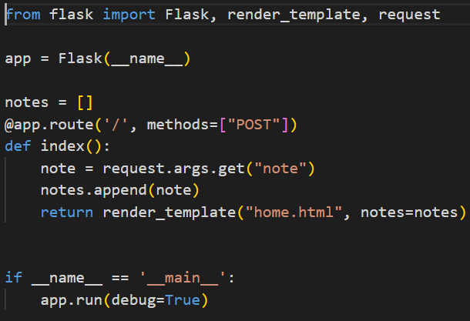
Bug Identification
Backend
The Flask application is only designed to handle post request from the frontend and note variable is trying to retrieve the data using request.args.get(“note”)

Slide 5
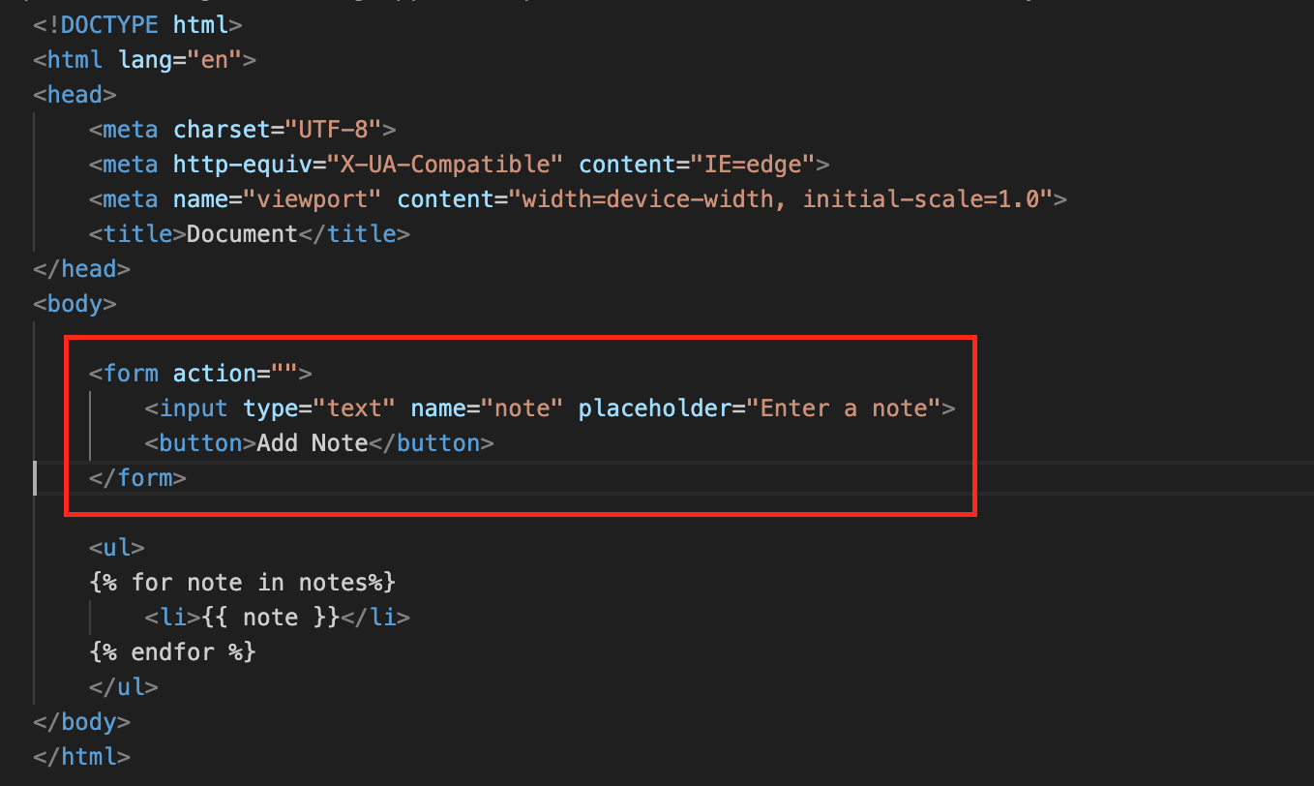
Frontend
Form doesn’t any have methods mentioned, by default form sends a “get” request and action is redirecting to anywhere.
Button doesn’t have any type mentioned in it.

Slide 6
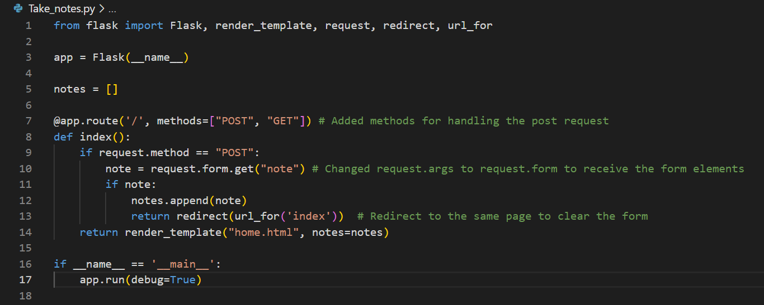
Bug Fixing
Backend
url_for('index') is used inside the redirect() function to generate the URL for the index endpoint. This ensures that the user is redirected back to the index route after submitting the form.
Added “get” method to handle both get method and post method to read the “form” data
Replace request.args.get(“note”) to request.form.get(“note”) and added one more condition to check if the input is empty, notes will not be added.

Slide 7
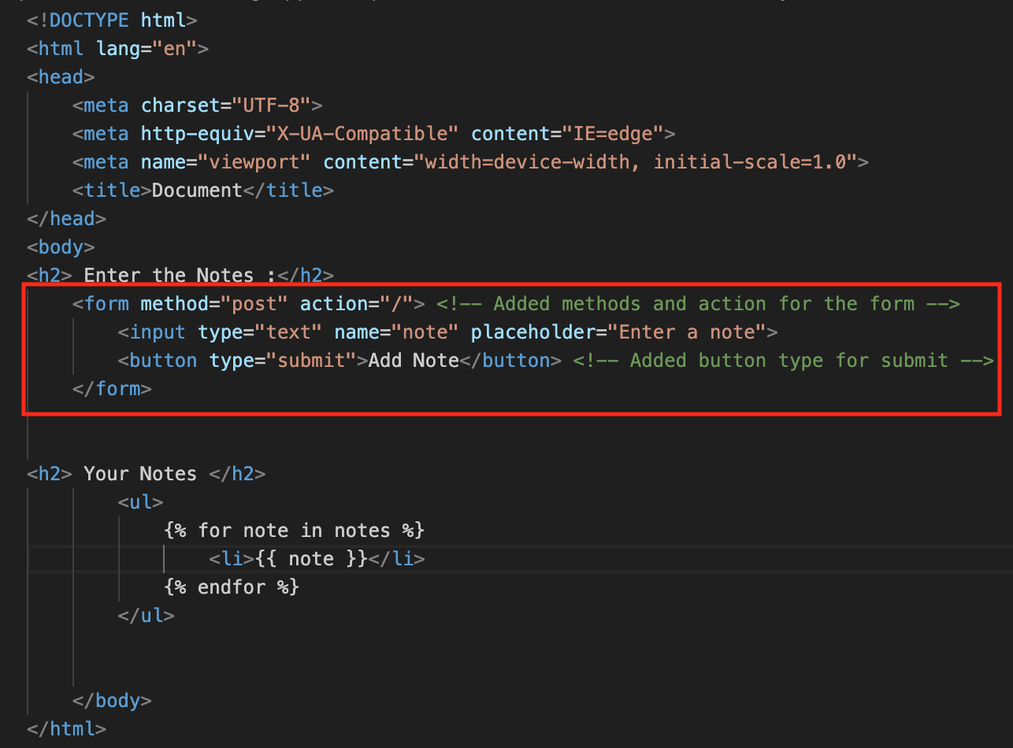
Frontend
Added form method and action will redirect to the home page
Added button type “submit” to send request for the form

Slide 8
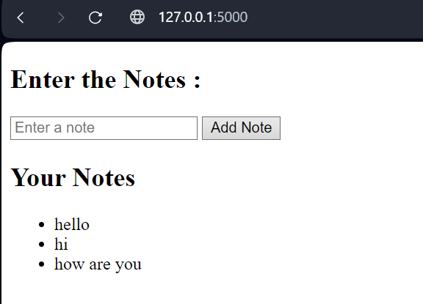
Conclusion
By adding the flask route to handle both the get and post request and also adjusting the logic to retrieve the post form data for the backend. And for the front end we added form action, http method and button type we were able to solve the identified bugs and the application is working successfully

Slide 9

THANK YOU

